Slide 1
Scholar Reflections

Slide 2
August Martin High School “Where Dreams Take Flight”
Chronic Absenteeism
November 5, 2016
Notes:
Add the video to the front end of the presentaton…Put small slop

Slide 3
Vision & Mission
August Martin High School is a small learning community focused on meeting the individual social, emotional and academic needs of every scholar. Our staff is invested in creating student-centered learning opportunities focused on student application of 21st Century skills. We partner with parents, our Community Based Organization and our scholars to advocate for and promote high expectations of achievement through a caring and supportive network. Our aviation and culinary programs allow scholars to explore career interests in an academic setting. August Martin’s mission is to educate and inspire leadership, compassion and perseverance in every scholar.

Slide 4
August Martin High School Core Values
Leadership
Scholarship
Perseverance
Integrity
Collaboration
Advocacy
Communication
Inquiry

Slide 5
Our Reality: Why are scholars chronically absent?
Scholars lacked parental / family support
Scholars were overwhelmed by the lack of credit accumulation
Scholars encountered domestic obstacles
Scholars had social and emotional challenges

Slide 6
The Idea…
How do we begin to address chronic
absenteeism?

Slide 7
THE DATA WISE SWOOSH

Slide 8
The Path in the Swoosh

Slide 9
The Path in the Swoosh

Slide 10
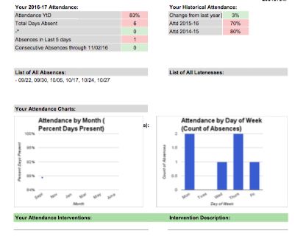
Our Data Source: Attendance Heat Map

Slide 11
Focus Questions
How do we support our school community in collaboratively giving scholars reasons to come to school while not compromising rigor?
How do we build trust between stakeholders?
How do we build a community where all stakeholders feel the urgency necessary to propel student achievement?

Slide 12
Prioritizing Meeting Times & Norms
All stakeholders were required at every meeting:
Principal
Assistant Principal
CBO Director
Guidance Counselor
Attendance Teacher
Community Associate
Parent Coordinator
Parents (where appropriate)
Team Leaders (where appropriate)

Slide 13
Engaging Parents
Daily:
phone calls
home visits
letters
Invitations into the building for:
Parent meetings with the attendance team
Attendance workshops
Extended Cabinet
Parents cook with their scholars evening
Thanksgiving feast

Slide 14
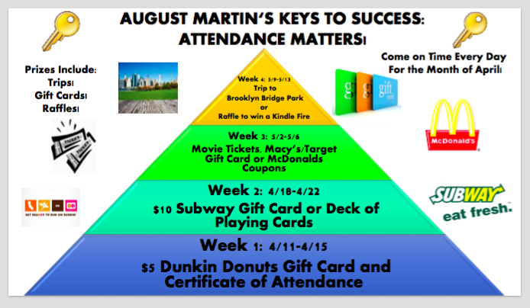
Engaging Scholars
Grade Community Gatherings
August Martin Bucks
Open Gym
College Trips
Monthly Lunch
Advisory
PM School
School Based Wellness Center

Slide 15
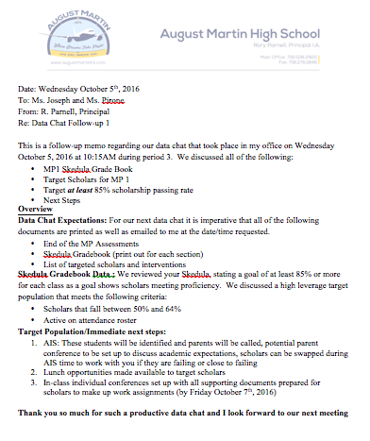
Engaging Teachers
Professional development emphasizing advisory curriculum
Data chats with Principal
Skedula
Professional development on using assessment in instruction - all scholars:
are contributing to how they are being assessed
have a chance to give and receive feedback from peers
have an opportunity to monitor their progress and make revisions based on a variety of feedback throughout the semester

Slide 16
Celebrations
Scholarship Report
English - 76%
Math – 82%
History – 85%
Science – 84%
Gym – 87%
Music – 83%

Slide 17
Celebrations
Attendance Data
September 2015 – 2016: 73%
Year To Date: 83%

Slide 18
Celebrations
No Show Data
No shows in September 2016: 34
Close of October 2016: 9
Of the 34 no shows: 20 are currently active students after interventions

Slide 19
Scholar Reflections

